Slide 1
Microsoft Power Platform Overview
Sohanur Rahman Sohan
Power Platform Developer at Data Crafters

Slide 2
Agenda
What is Microsoft Power Platform?
Traditional Software Development vs. Low-Code/No-Code Development
Key Components Overview
Power Apps
Power Automate
Power BI
Power Virtual Agents
Market Demand and Business Perspectives
Integration and Real-World Use Cases
Governance and Best Practices
Q&A and Next Steps

Slide 3
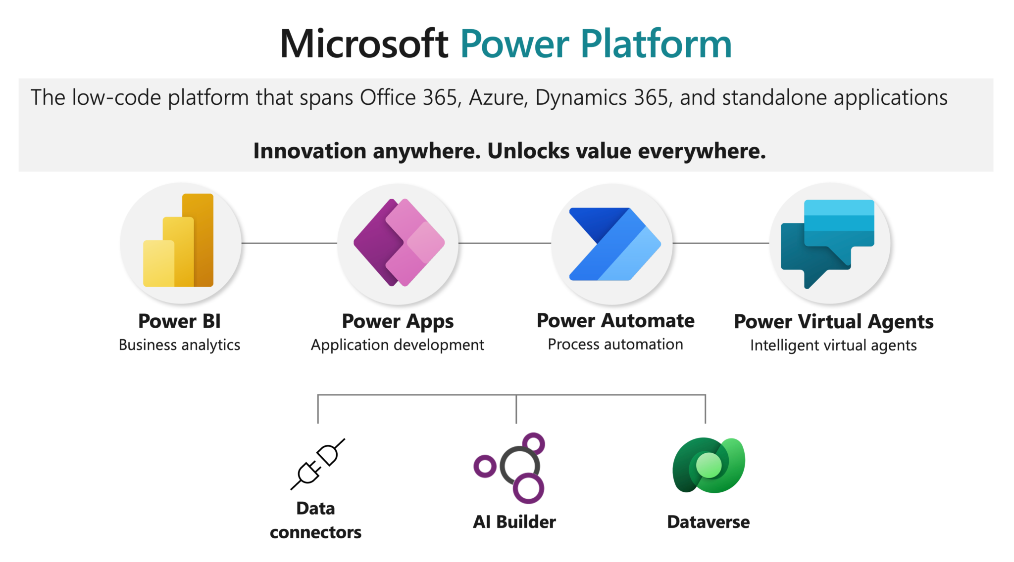
What is Microsoft Power Platform?

Slide 4
What is Microsoft Power Platform?
Definition: A suite of tools for building apps, automating workflows, analyzing data, and creating chatbots.
Core Benefits:
Low-code/no-code development.
Seamless integration with Microsoft 365, Dynamics 365, and Azure.
Supports citizen developers and professional developers.
Key Pillars:
Power Apps: Build custom apps.
Power Automate: Automate repetitive tasks.
Power BI: Gain insights from data.
Power Virtual Agents: Build intelligent chatbots.

Slide 5
Traditional Software Development vs. Low-Code/No-Code Development
Traditional Development:
High coding effort and longer development cycles.
Requires skilled developers.
High costs for maintenance and updates.
Low-Code/No-Code Development:
Faster app creation with drag-and-drop tools.
Empowers non-developers (citizen developers).
Lower costs and quicker iteration.
Benefits of Low-Code/No-Code:
Rapid prototyping and deployment.
Bridges the gap between IT and business teams.
Reduces dependency on traditional development resources.

Slide 6
Market Demand and Business Perspectives
Growing Market Demand:
Low-code platforms expected to dominate software development.
Gartner predicts 70% of new applications will use low-code/no-code by 2025.
Business Benefits:
Increased agility and faster response to market needs.
Cost-effective solutions for small and medium businesses.
Democratizes app development, fostering innovation.
Importance for Organizations:
Drives digital transformation.
Enhances productivity and operational efficiency.
Provides a competitive edge in the market.

Slide 7
Power Apps
What is Power Apps?
A platform to create apps quickly without coding.
Types of Apps:
Canvas Apps: Drag-and-drop interface.
Model-Driven Apps: Data-centric and driven by Dataverse.
Power Pages: Build external-facing websites.
HomeWork:
Equipment Reservation and Tracking

Slide 8
Power Automate
What is Power Automate?
Automate workflows and tasks across apps and services.
Types of Flows:
Cloud Flows: Triggered online.
Desktop Flows: RPA for desktop processes.
Business Process Flows: Guided steps for business scenarios.
Demo Example:
[Automatically send email notifications for submitted feedback.]

Slide 9
Power BI
What is Power BI?
A tool to visualize and analyze data with interactive dashboards and reports.
Key Features:
Connect to multiple data sources.
Create and share real-time dashboards.
Enable data-driven decision-making.

Slide 10
Power Virtual Agents
What is Power Virtual Agents?
Build intelligent chatbots to handle queries and automate responses.
Features:
No coding required.
Seamless integration with Power Automate for advanced actions.
Demo Example:
Create a chatbot for common HR FAQs.

Slide 11
Integration and Real-World Use Cases
Integration Example:
A feedback app (Power Apps) connected to SharePoint.
Notifications (Power Automate) sent via Teams.
Dashboard (Power BI) analyzing feedback trends.
FAQ bot (Power Virtual Agents) for employee queries.
Industries:
Healthcare: Patient management apps.
Retail: Sales and inventory dashboards.
HR: Employee onboarding workflows.

Slide 12
Governance and Best Practices
Key Concepts:
Use environments to separate development, testing, and production.
Implement Data Loss Prevention (DLP) policies.
Monitor and optimize app performance.
Tips for Scaling Solutions:
Use Dataverse for secure data storage.
Standardize naming conventions.
Regularly review and optimize workflows.

Slide 13
Q&A and Next Steps
Q&A Session:
Next Steps:
Homework for Equipment Reservation and Tracking
Explore Microsoft Learn for tutorials.
Start building a simple app or workflow.
Join the Power Platform community for support.
Resources:
Microsoft Learn: https://learn.microsoft.com

